Slide 1
Advances to In-Car HMI Systems
SID Display Week, June 4, 2015
Stefan Marti, Ph.D., VP Future Experience
Rashmi Rao, Director CoC Systems
IP Park, Ph.D., CTO Harman
JUNE 3, 2015 (V1.6)

Slide 2

Problem
There will be more and more computers in cars: built-in, brought-in, worn, etc.
These computers want to interact with us (and we with them).
© Janus Yuang
If not designed and engineered appropriately, the user interfaces between us and these computers will become more complex—and more distracting.
This is not acceptable.

Slide 3
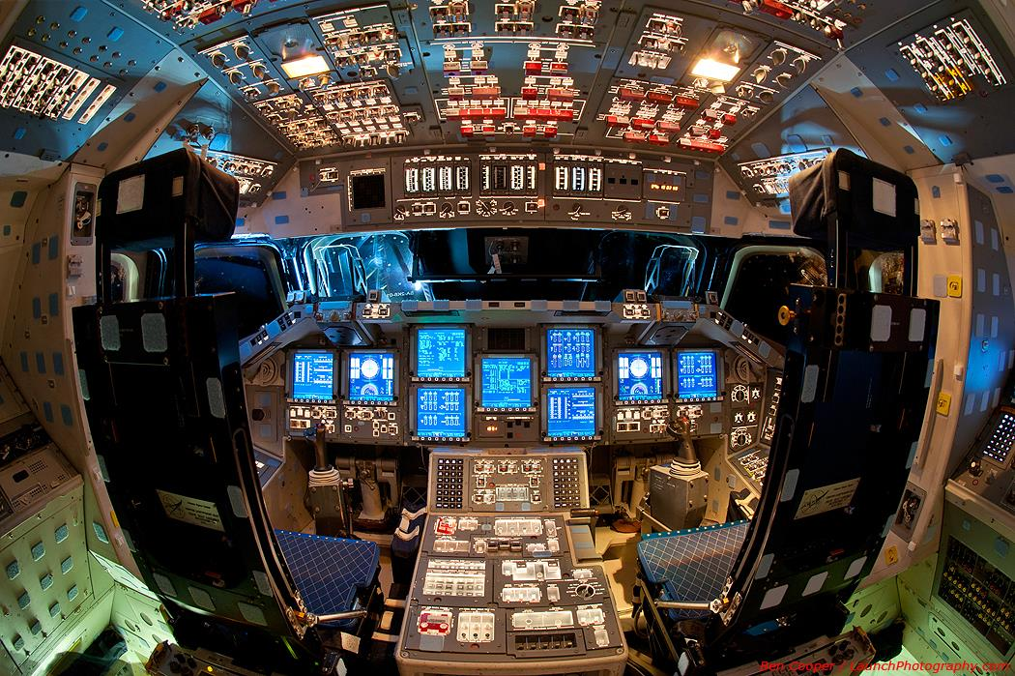
This is not acceptable.

Slide 4

Information overload
The current ways how we interact with computers is distracting from our main task in the car.
That is because today’s HMI methods depend mostly on our eyes and ears.
These senses tend to become overloaded.

Slide 5
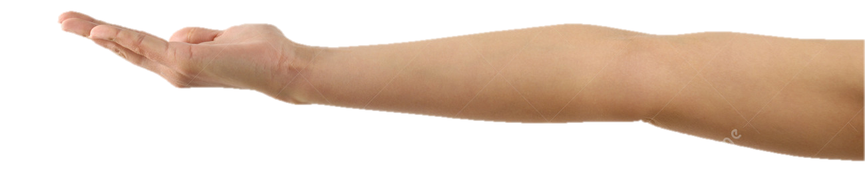
Solution 1: more than just eyes and ears
First, we need to “load balance” our senses.
Our fingers are usually telling computers what to do—but they can also sense, e.g., what the car wants to tell us.
And not just our fingers: we can also sense with our palms, wrists, even forearms.

Slide 6

Solution 2: spatial interfaces
Second, we need to use people’s spatial perception better.
Right now, many output methods are flat: displays, sounds.
When interfaces become spatial, they become easier for us humans to comprehend.

Slide 7

Solution 3: sensing non-verbal language
Third, we need to pay attention to people’s subtle non-verbal cues. Very few interfaces do so currently.
Our face, e.g., can convey information which should be important for our systems: it may show what we really want, or think, or feel.

Slide 8
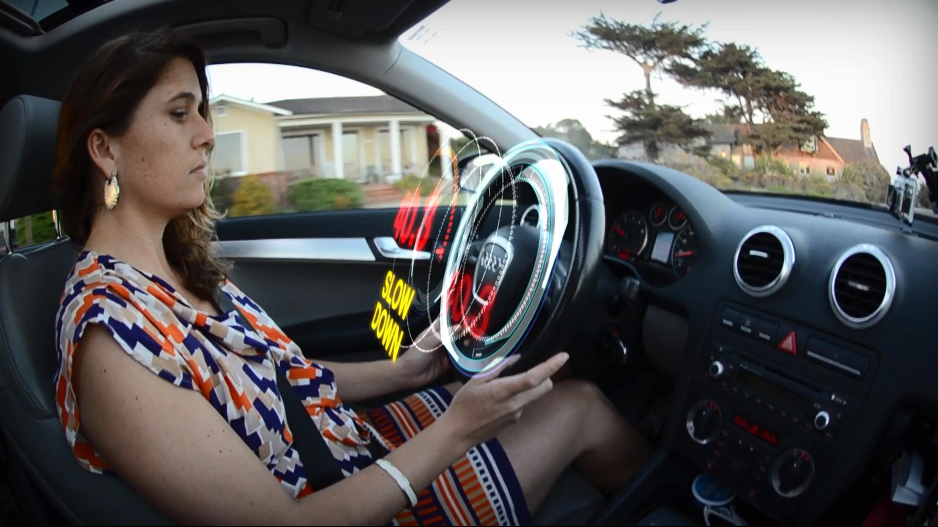
Pseudo Holographic Display Systems
1

Slide 9

Pseudo holographic display Systems
  Spatial Interface
Spatial
Core idea
Pseudo-holographic display systems take advantage of volumetric space between driver and steering wheel.
Alerts and important information, such as a speeding notification, can become more prominent by getting closer to the driver.
Machine intelligence decides which information is most relevant, and dynamically determines priority and position in space.
Technology
  Autostereoscopic display
  View dependent rendering
  Adaptive UI with context awareness

Slide 10
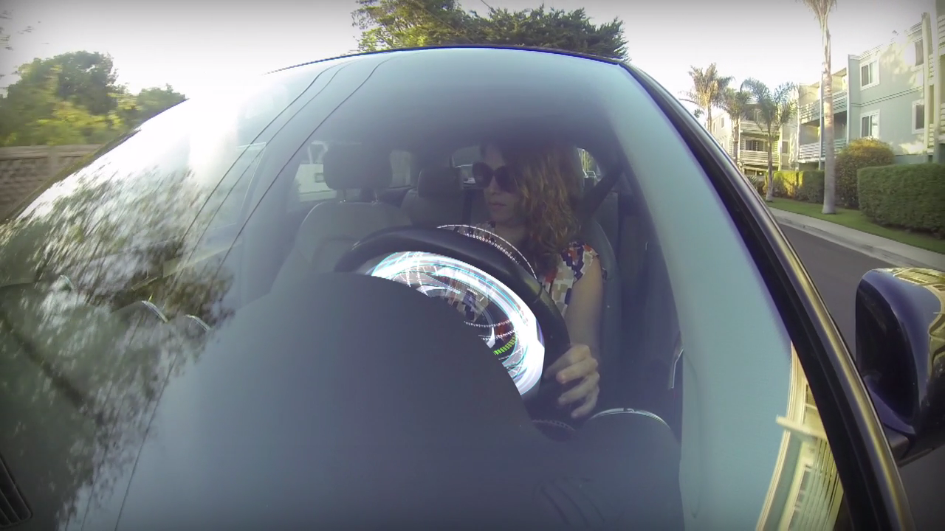
Stereoscopic 3D Instrument Cluster

Slide 11
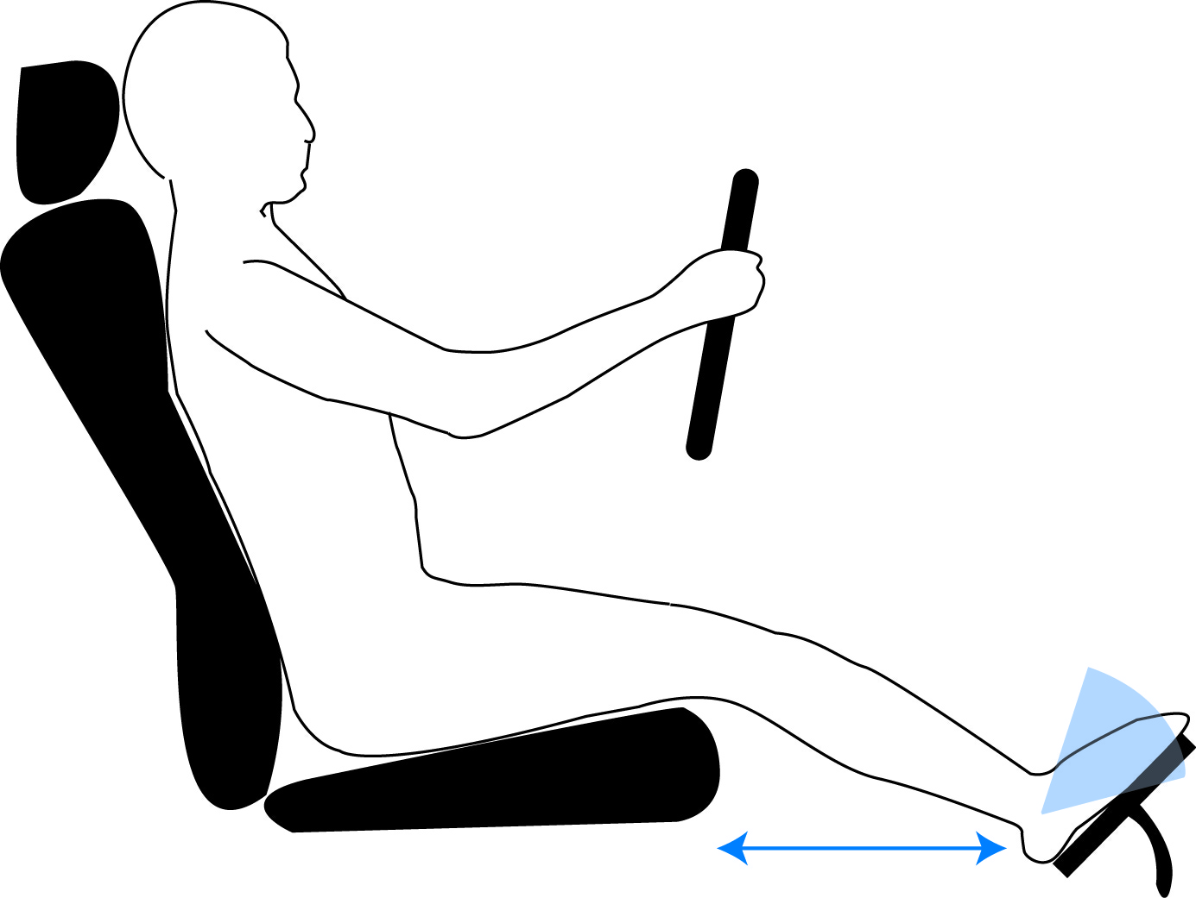
Config 1: 3D display behind wheel
Uppermost layer, e.g., speedometer and RPM gauge highly transparent
Medium layer with other information, e.g., time, mileage: transparent
3D field in front of steering wheel, with display behind steering wheel (seen through opening in steering wheel)
Backmost layer, e.g., for 3D map: opaque
RPM
Other information
Speed
Map
3D display on dashboard
Notes:
But where should the display get mounted?

Slide 12
Config 2: 3D display on steering wheel
All layers with positive parallax (“pop up”)
Additional 3D display on steering wheel
Secondary display on steering wheel, 3D field behind steering wheel (“pop back”)
RPM
Other information
Speed
Map

Slide 13
Config 3: 3D display on dash
Two front layers with positive parallax (“pop up”)
3D field above steering wheel; some layers with negative parallax
RPM
Other information
Speed
Map
3D display above dashboard
Backmost layer with negative parallax (“pop back”)

Slide 14
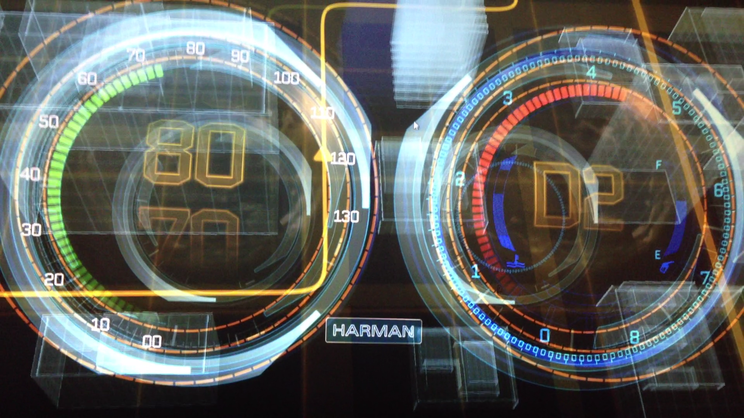
Transparent Instrument Cluster demo

Slide 15
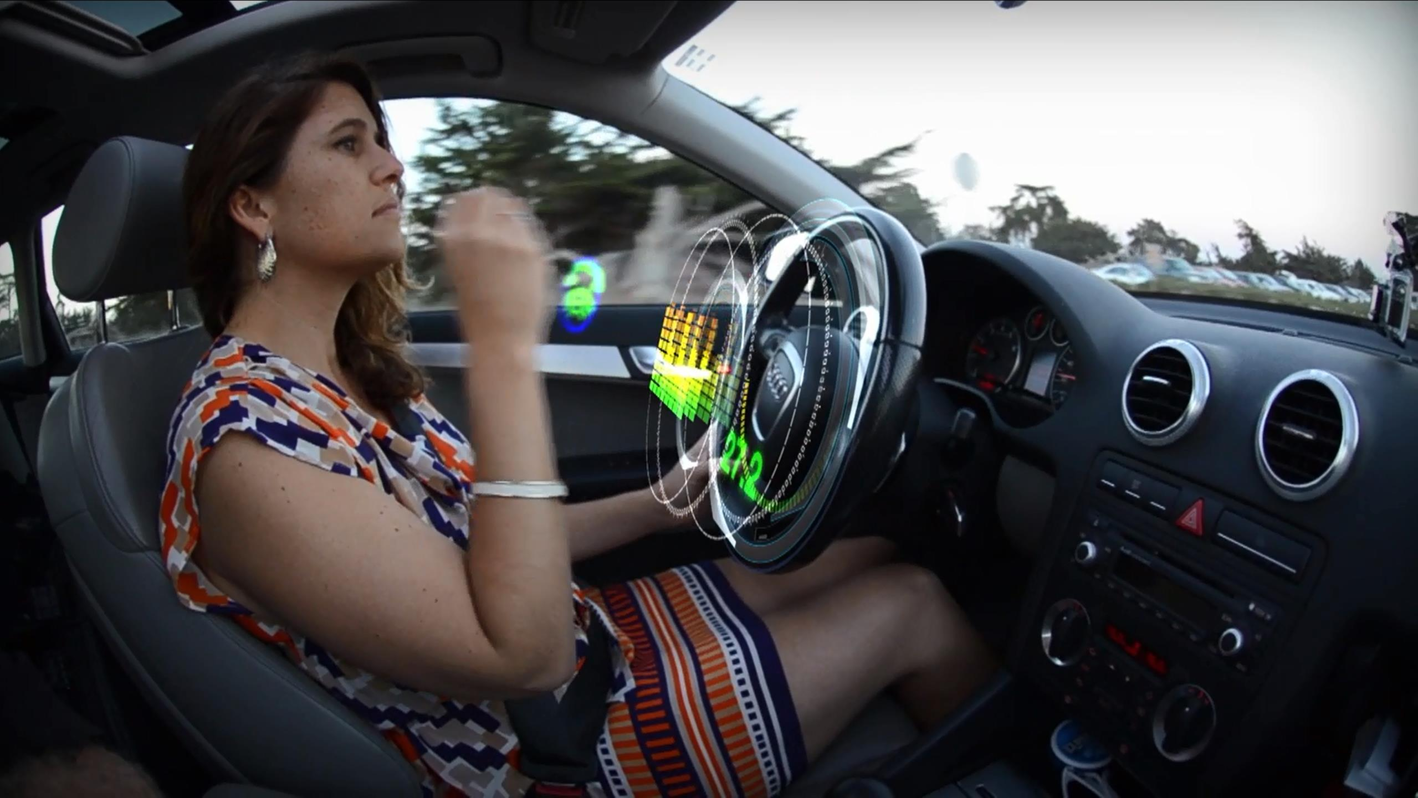
Gestural Control of In-Vehicle Sounds
2

Slide 16
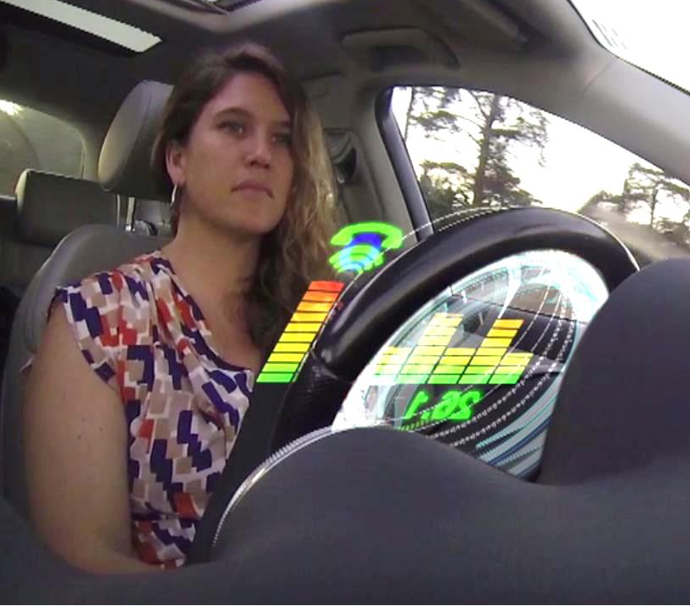
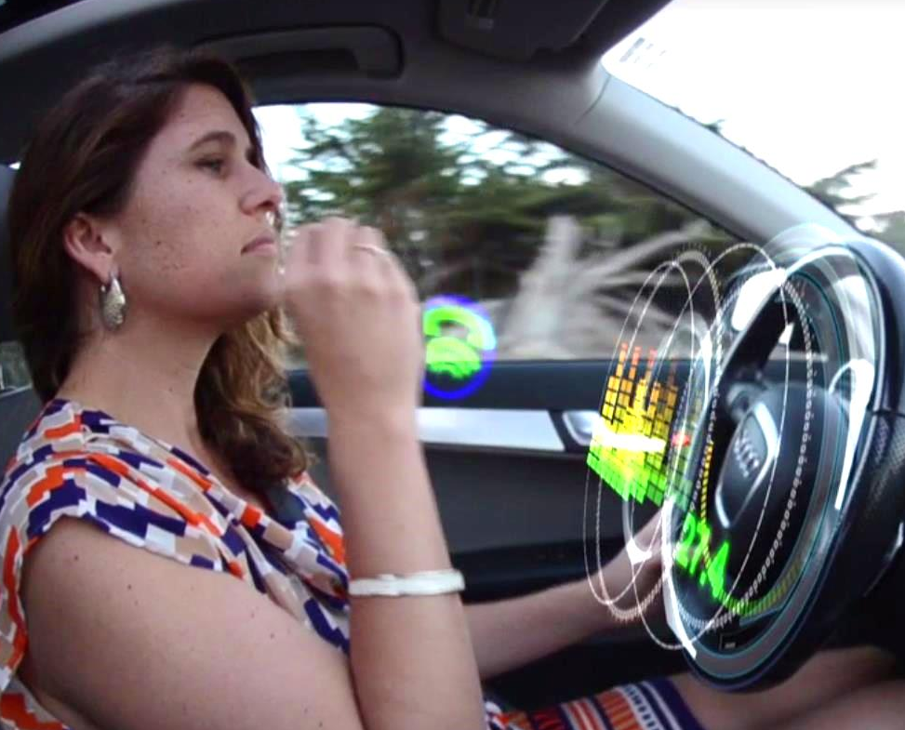
Gestural Control of In-Vehicle Sounds
  Spatial Interface
Spatial
Core idea
Driver can use intuitive gestures, such as grasp and pull, to control volume and perceived location of audio events.
Can also be used to activate audio events, such as answering a phone call.
Such as system makes sense when paired with a 3D instrument cluster, or with individual sound zones (ISZ).
Technology
  Gesture sensing
  Surround or 3D sound system
Icon of ringing phone, and 3D location of audio point source
Driver pulling sound (ringing phone) towards her ear

Slide 17
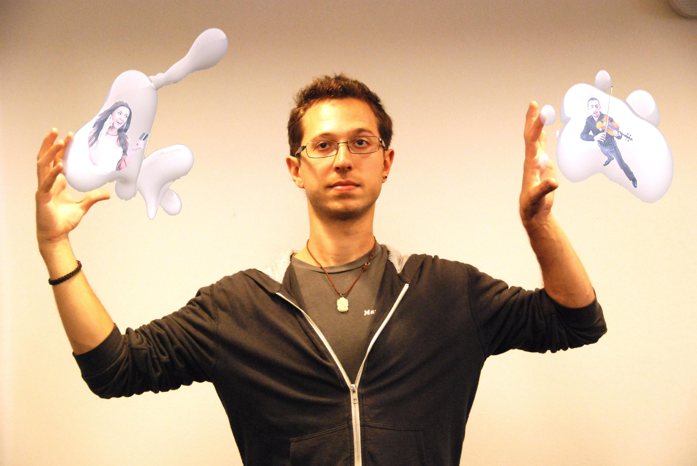
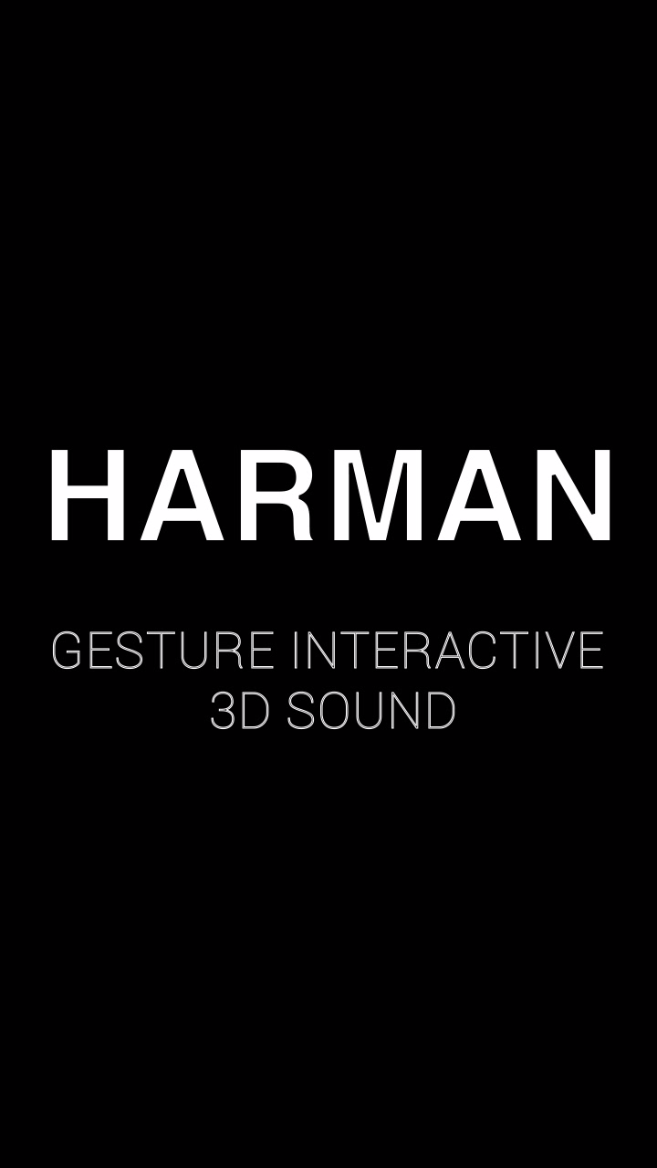
Bare-hand Manipulating sound
Notes:
This interaction method works well not only in the car, but also in other situations. Here is a brief concept video of a desktop use case:

Slide 18
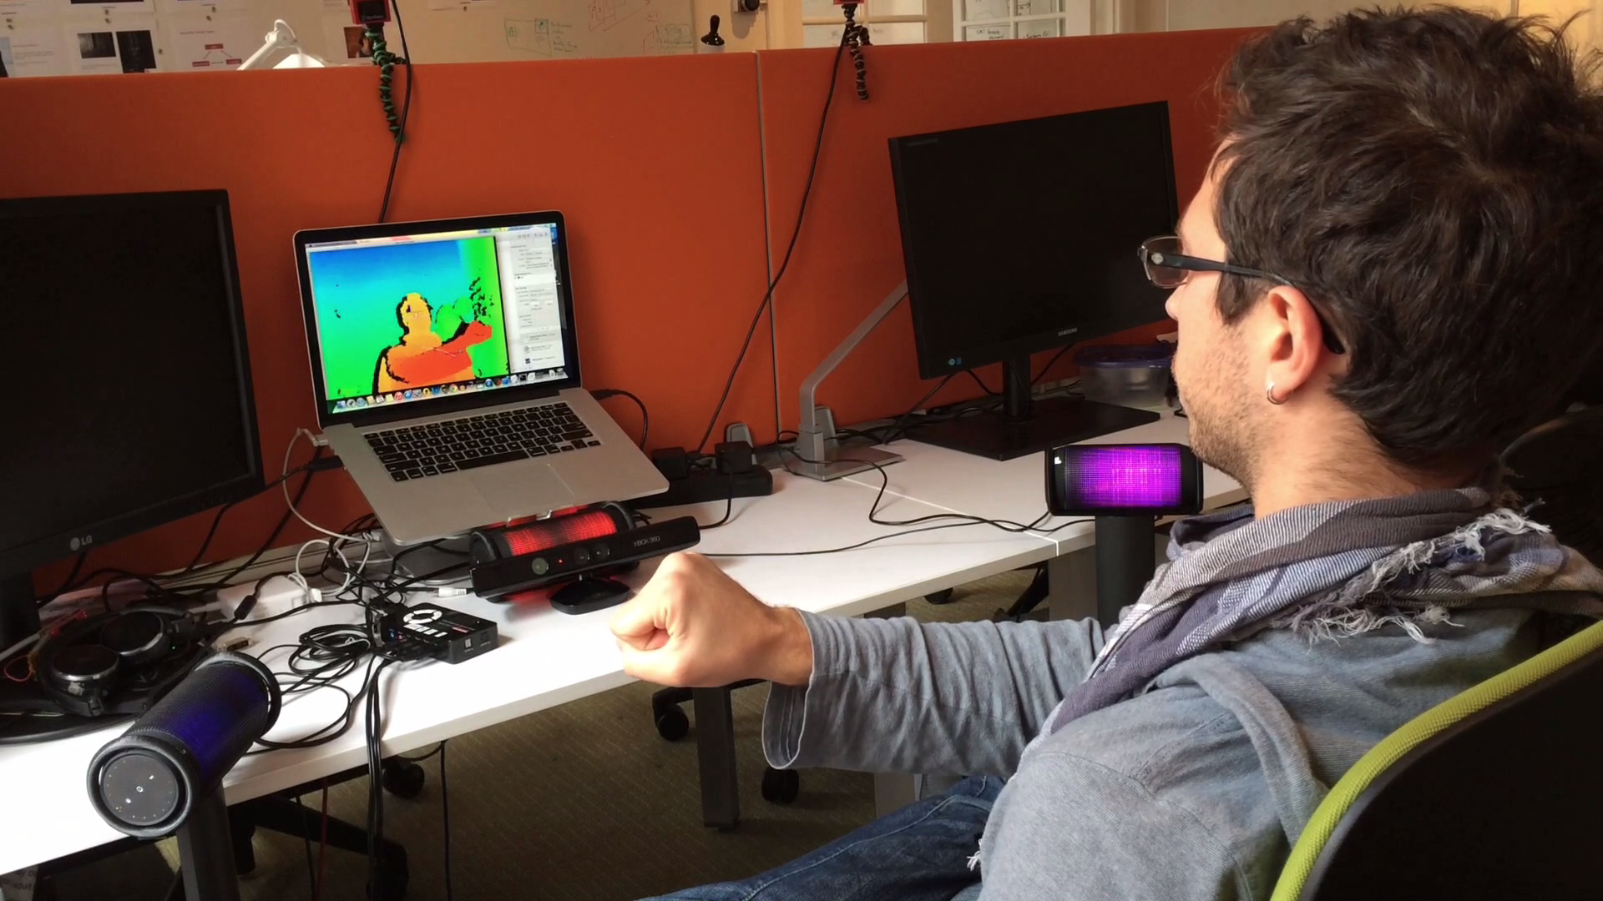
proof-of-concept prototype

Slide 19
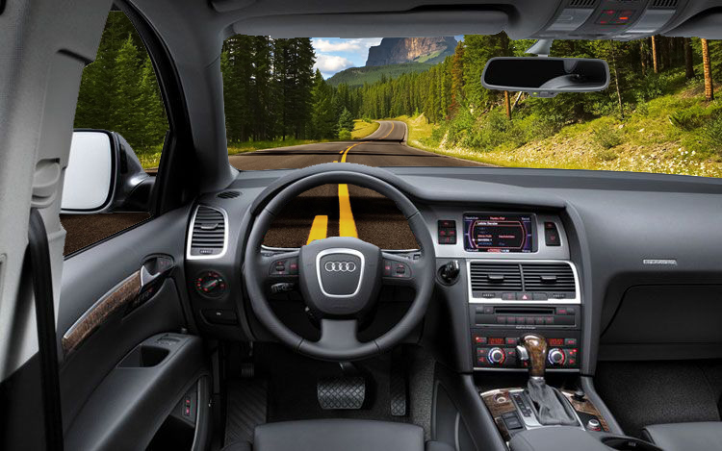
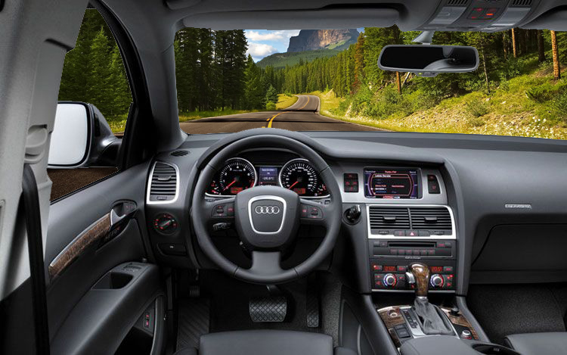
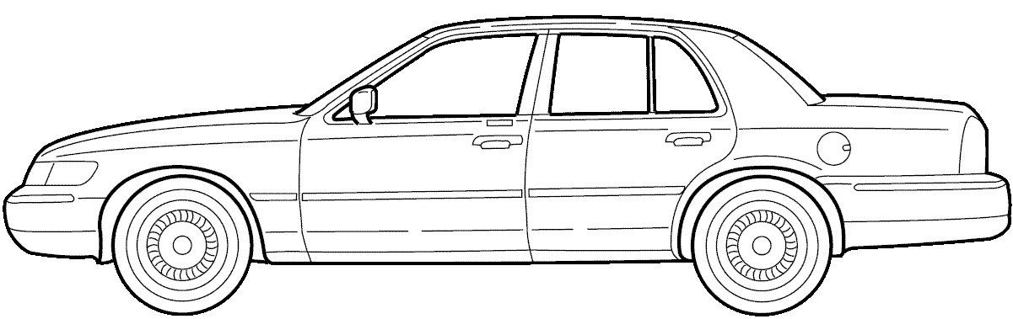
See-Through-Dash Display Systems
3

Slide 20

See-Through-Dash Display Systems
  Spatial Interface
Spatial
Core idea
Being able to see through the dash gives the driver an augmented field of view of the road in front of the vehicle.
This increases the spatial awareness for the driver.
System aims to convey a similar effect to a virtual hole through the engine or a partial glass-cockpit.
Technology
  Pseudo holographic 3D display
  Stereo imagers, physically or virtually actuated
  Driver face tracking for view dependent rendering

Slide 21
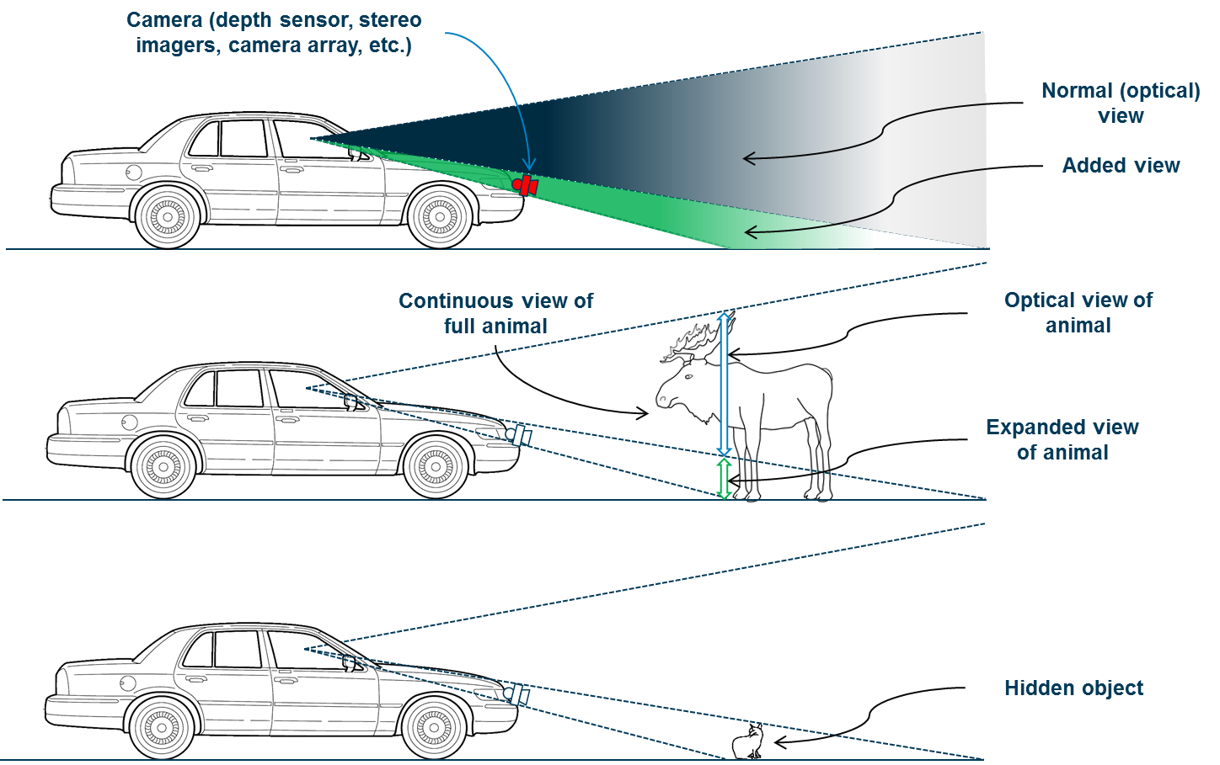

Slide 22
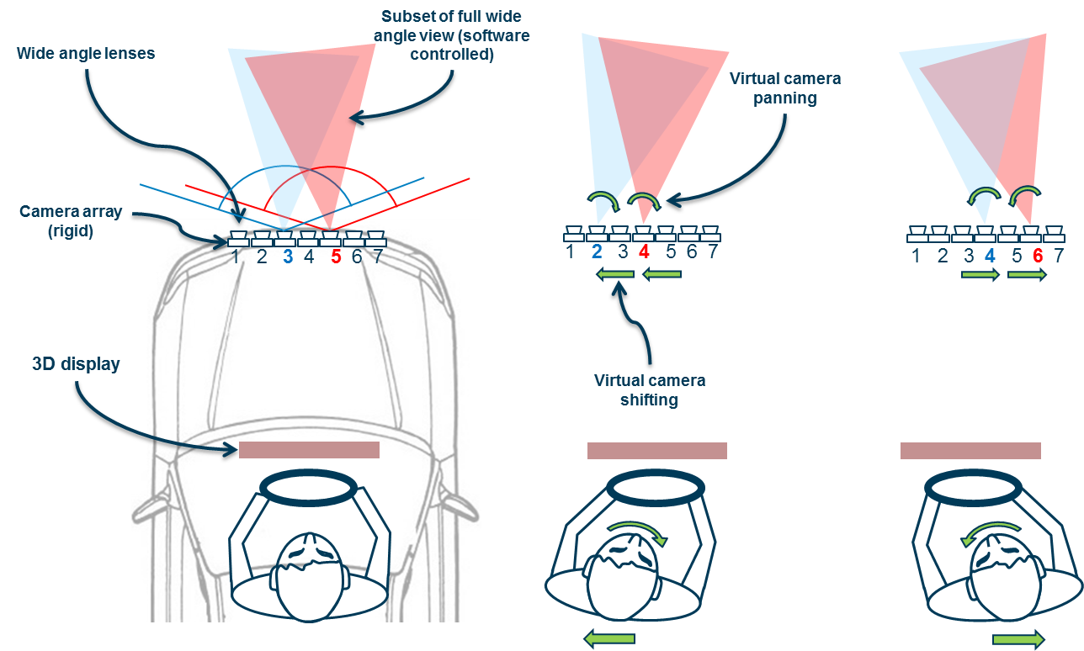
array of cameras

Slide 23
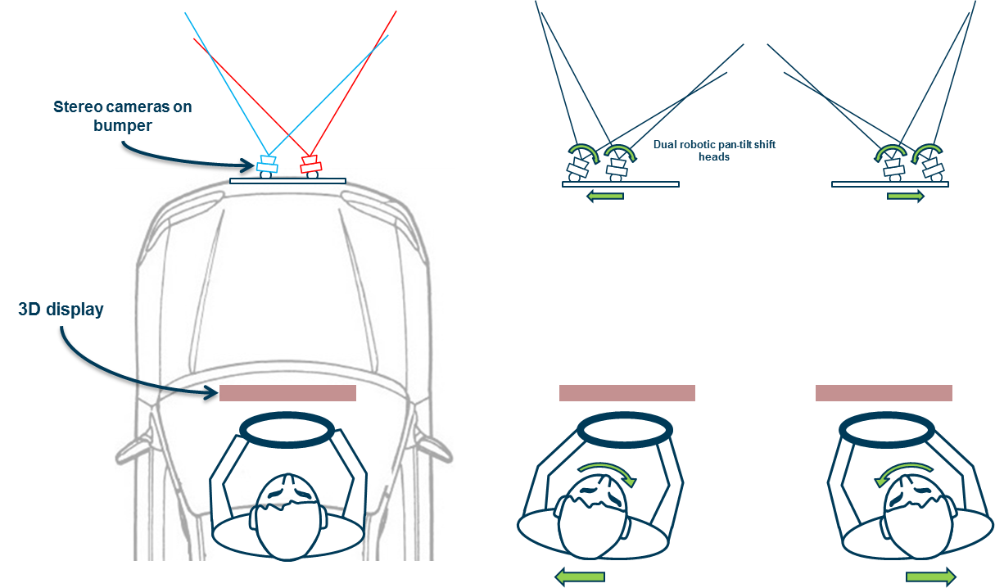
Pan-tilt cameras

Slide 24
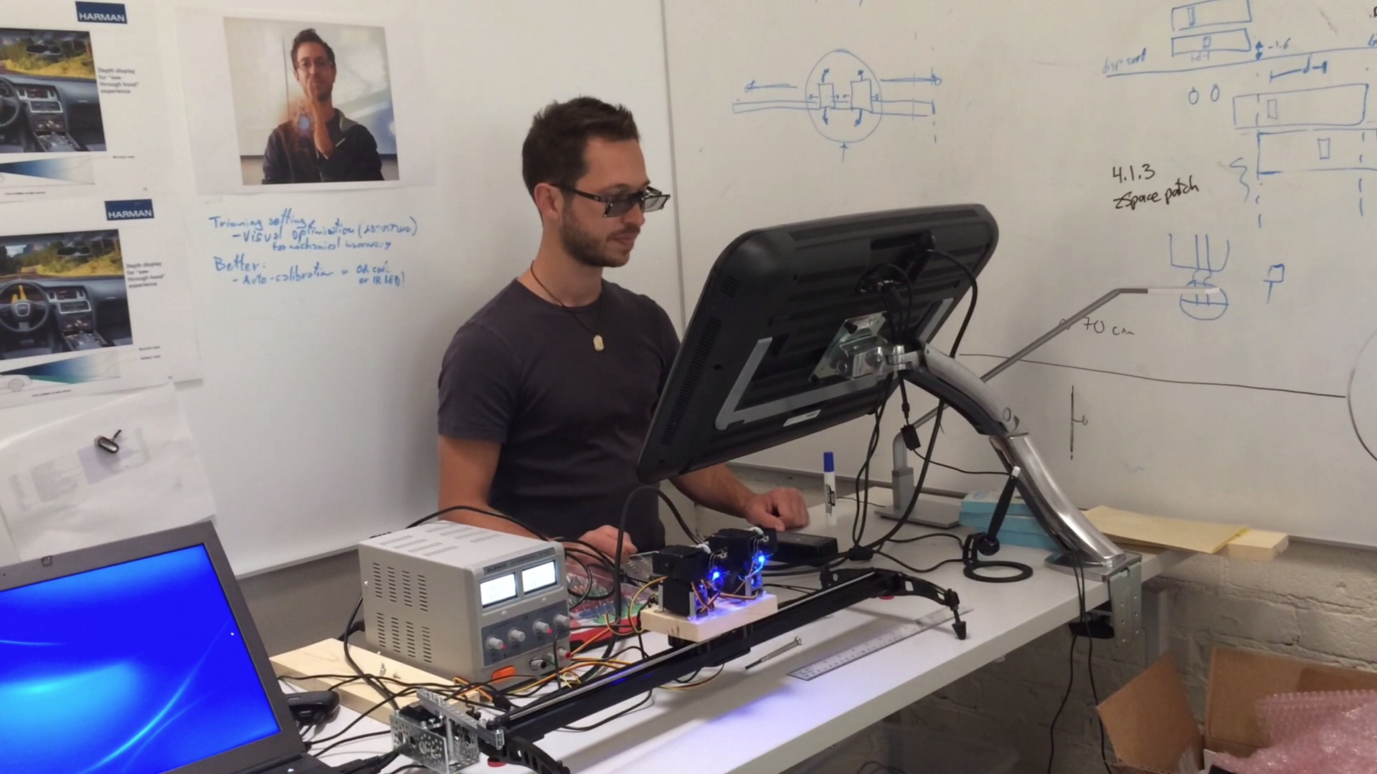
Proof-of-concept prototype
[video of demo 3D See-Through]

Slide 25
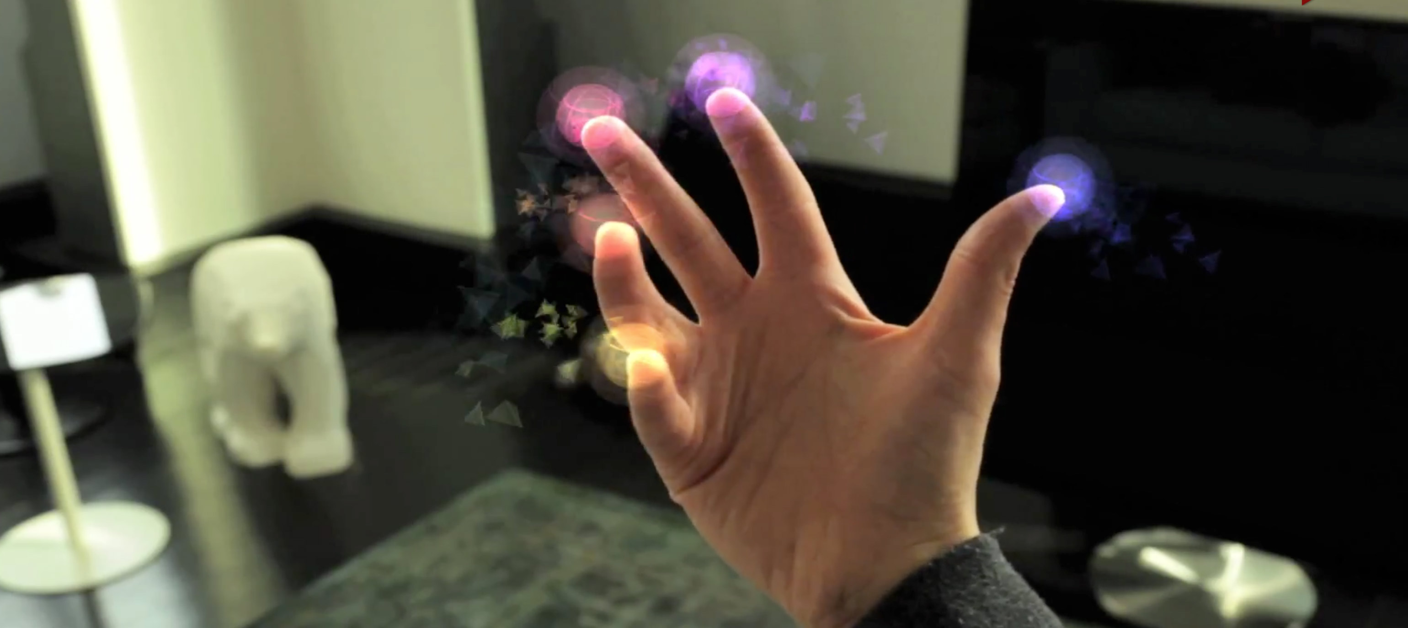
In Mid-Air Tactile Feedback Systems
4

Slide 26

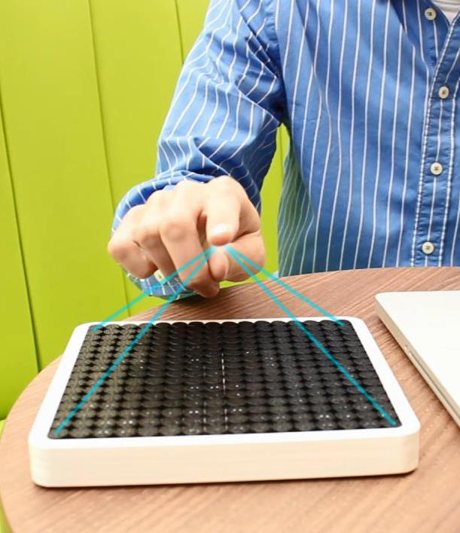
In MID-AIR TACTILE Feedback Systems
  Non-verbal
  Feel & Touch
  Spatial Interface
Balance
Spatial
Core idea
System which gives the driver tactile feedback in mid-air.
This feedback is in sync with visual and auditory 3D UI, supporting it. For example, a visual icon or UI element of a 3D display becomes tangible, in mid-air.
This closes the interaction loop of spatial displays and spatial sound with haptic experience, creating “illusory haptic objects”.
Technology
  Ultrasonic parametric transducer array
  Finger tracking sensor

Slide 27
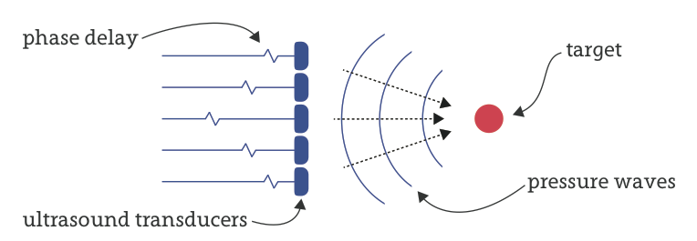
How it works
Hand/fingers are tracked by sensor
Transducer phased array sends waves of ultrasound to a localized focal point
A pressure difference is created at the focal point, and exerts a force on user’s fingers
This tactile feedback is only felt at the exact focal point (neither above or below, etc.)
Multiple focal points are possible (sequentially), creating impression of 3D objects on user’s hand

Slide 28
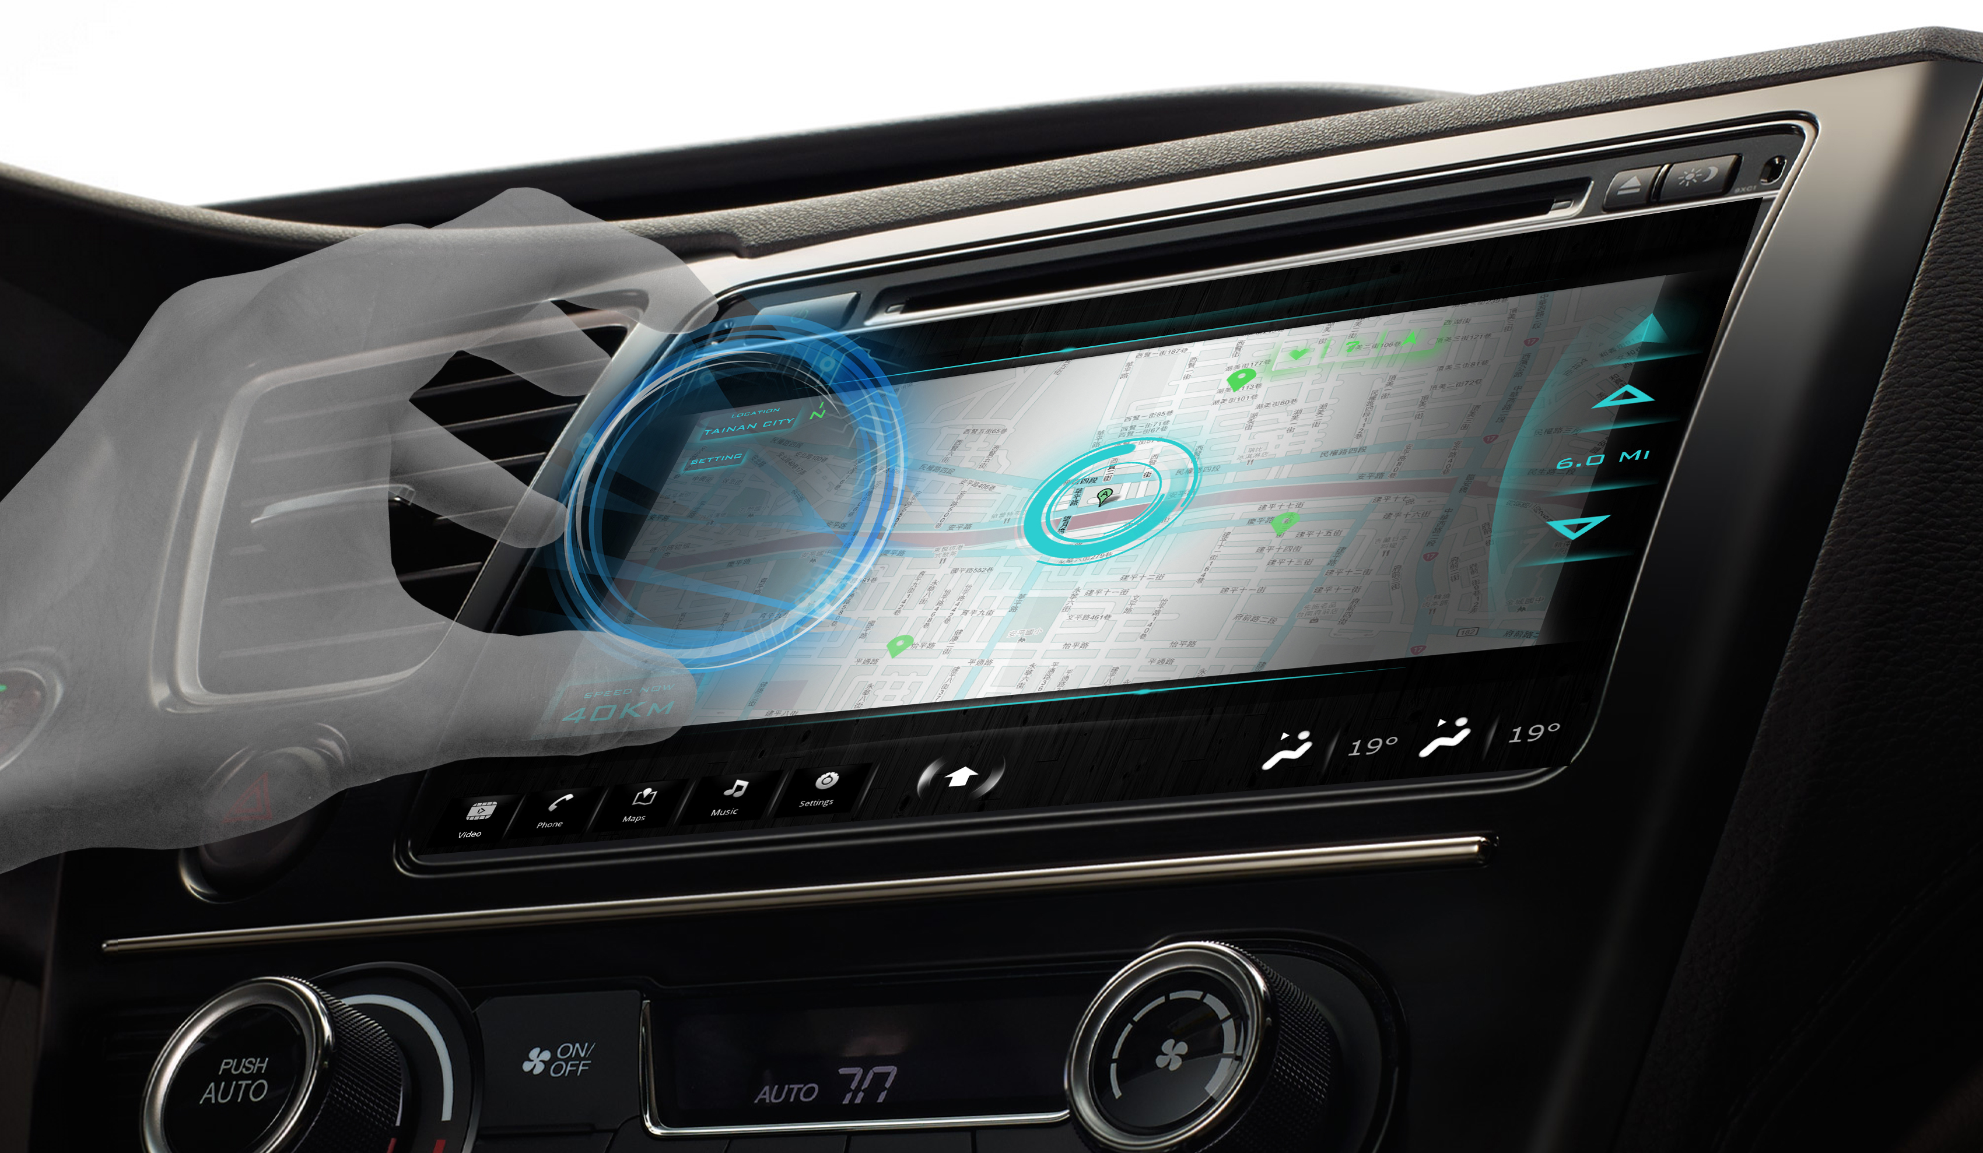
Rowland to add slides

Slide 29
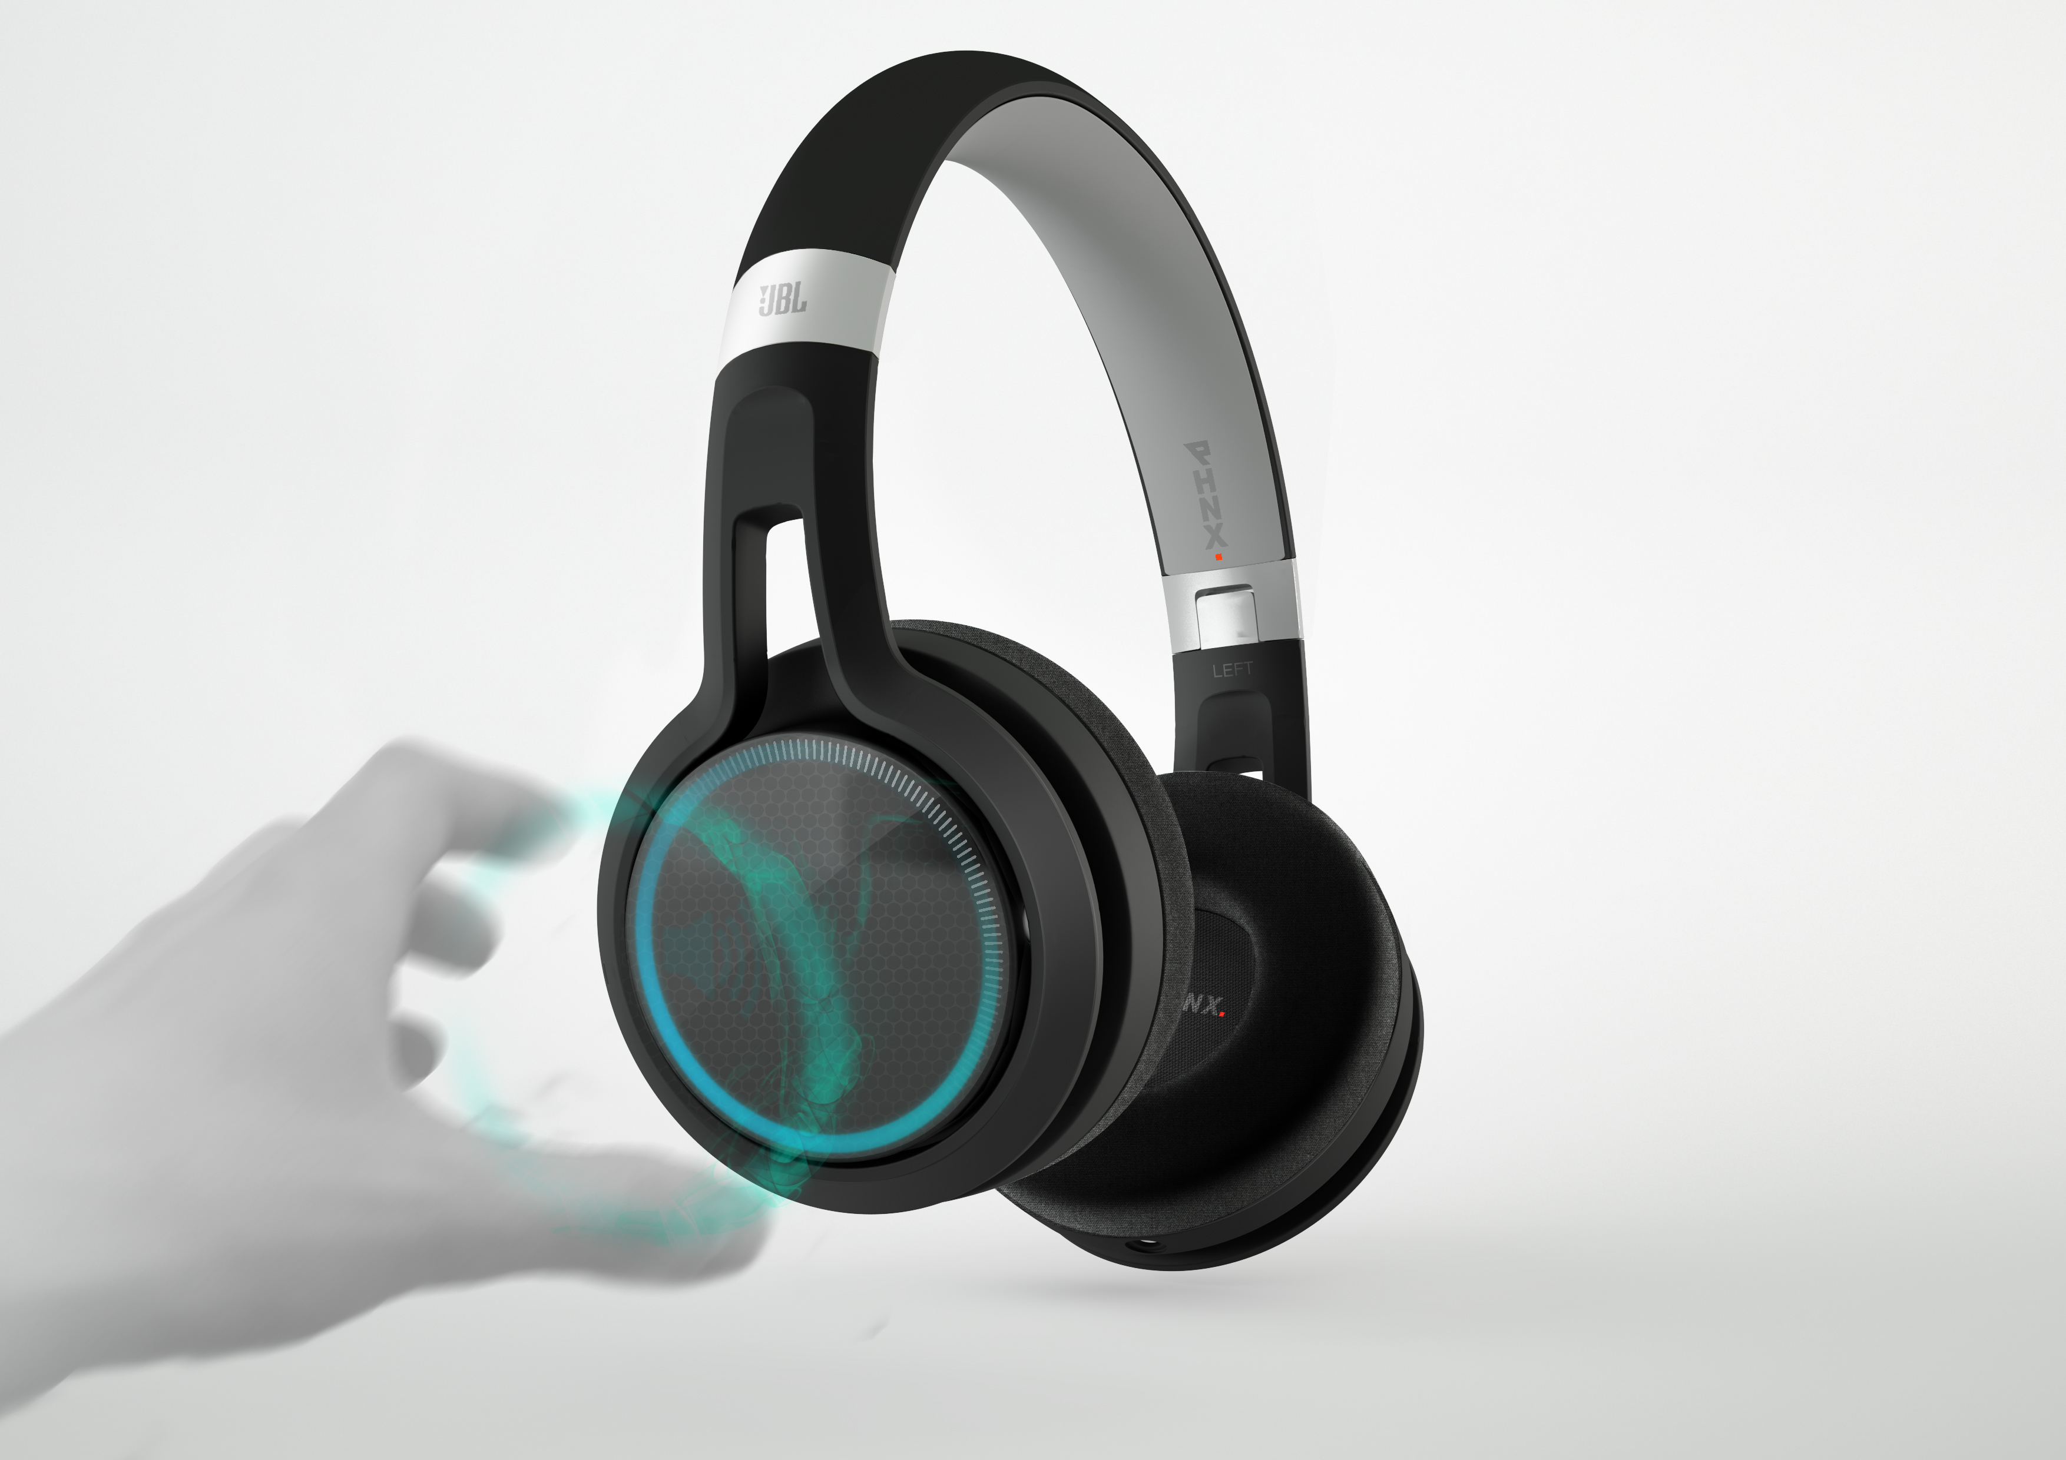

Slide 30
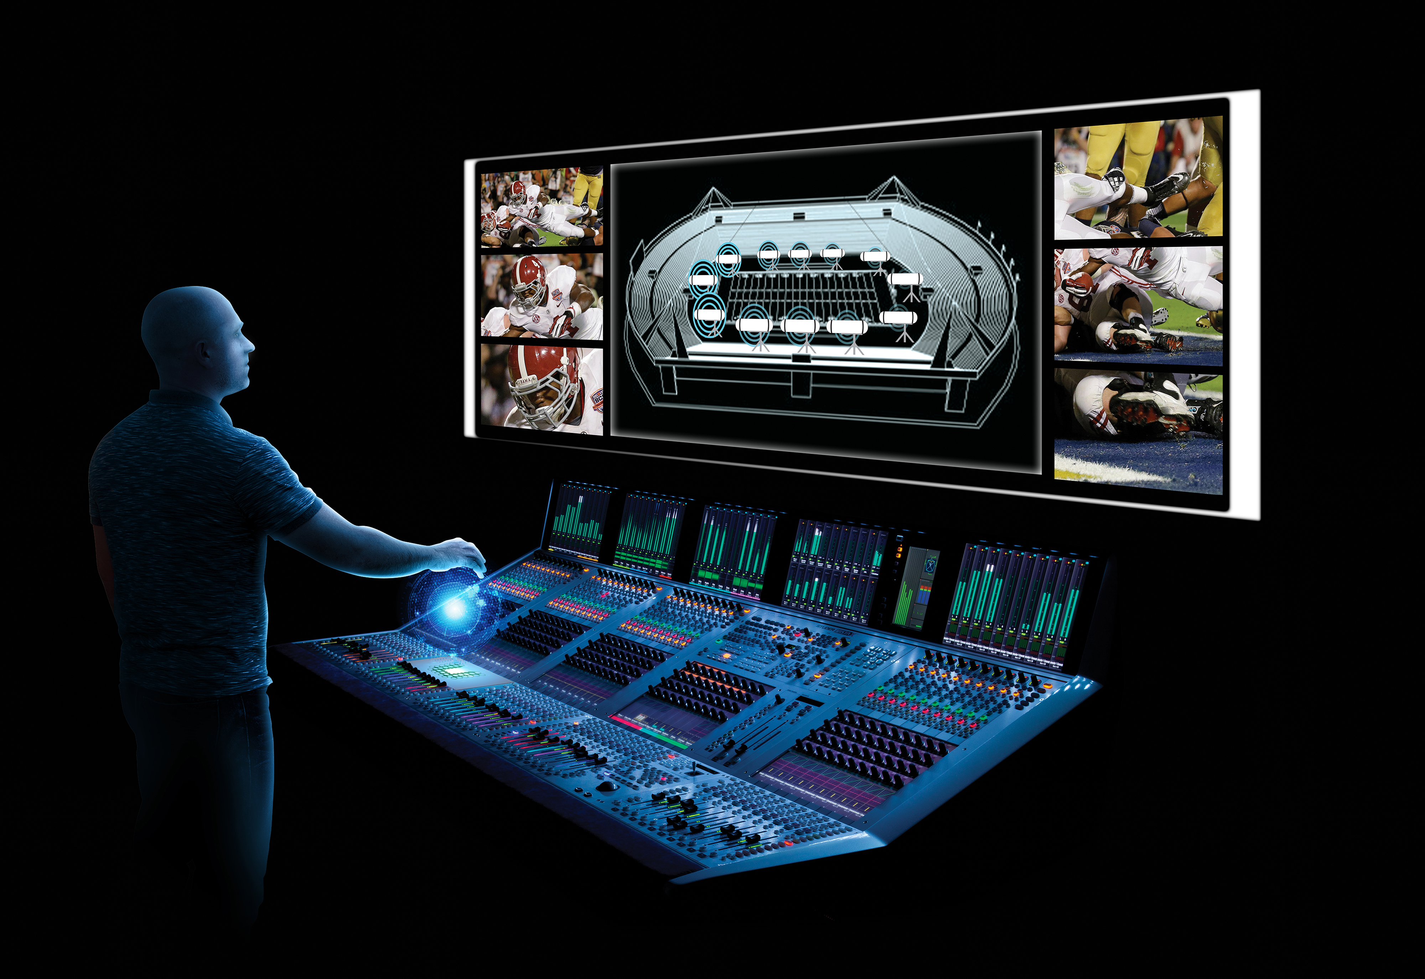
Notes:
Looking out a little further. We also believe that Ultrahaptics can improve the user experience in our Professional Division, particularly in our mixing product line.
The mixing board operator wants to have his or her eyes on the live event rather than on the control surface. This is a technical challenge and gesture control enhanced by tactile feedback can improve the experience.
One application is called 3D Panning Control.
For example, at an American Football game multiple microphones are placed around the field to capture the emotion of the athletes during game. That sound has to be blended against the stadium background noise. Microphones have to be faded in and out according depending where action is. This is a very dynamic situation. The current solution is to use a joystick to control the channels. A gesture control system to will enable a more intuitive and agile control of the microphones. With the use of the haptic feedback, the operator may feel a virtual control point in the space and use it as the reference to change the equalization of the microphones in a very confident and natural way.

Slide 31
Advancing in-car HMI Systems
  Spatial Interface
  Use people’s spatial perception capabilities: create spatial interfaces
  Use more than just eyes and ears: “load balance” our human senses
  Sense people’s non-verbal cues to understand what they really want: from explicit to implicit interaction
  Feel & Touch
  Non-verbal

Slide 32
THANK YOU!

